Slide 1
Christmas

Slide 2
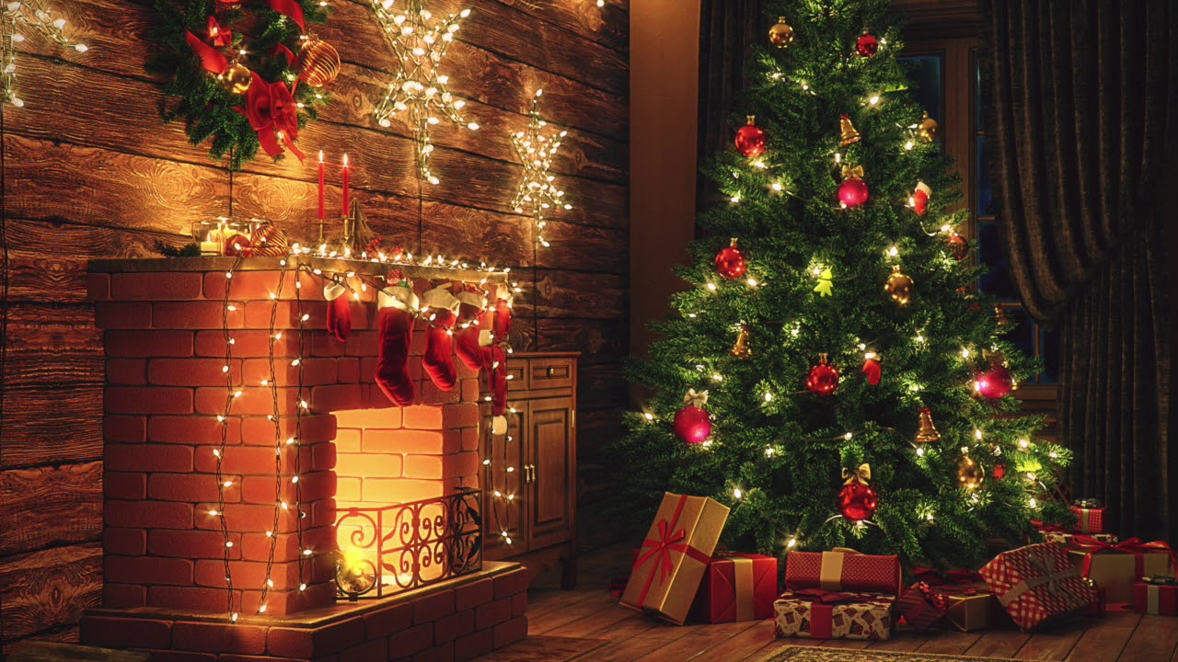
Christmas is one of the most important holiday for polish people. It begins on 24th December and lasts three days, but preparations start a few days before. People buy presents, send Christmas cards to their family and friends, clean houses, cook Christmas dishes and decorate Christmas trees.

Slide 3
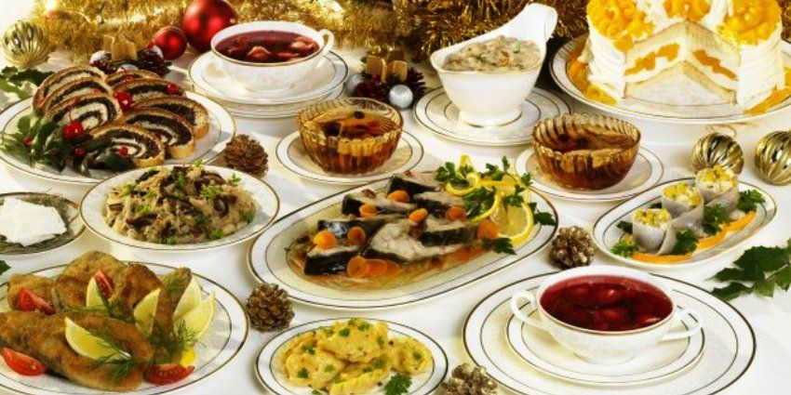
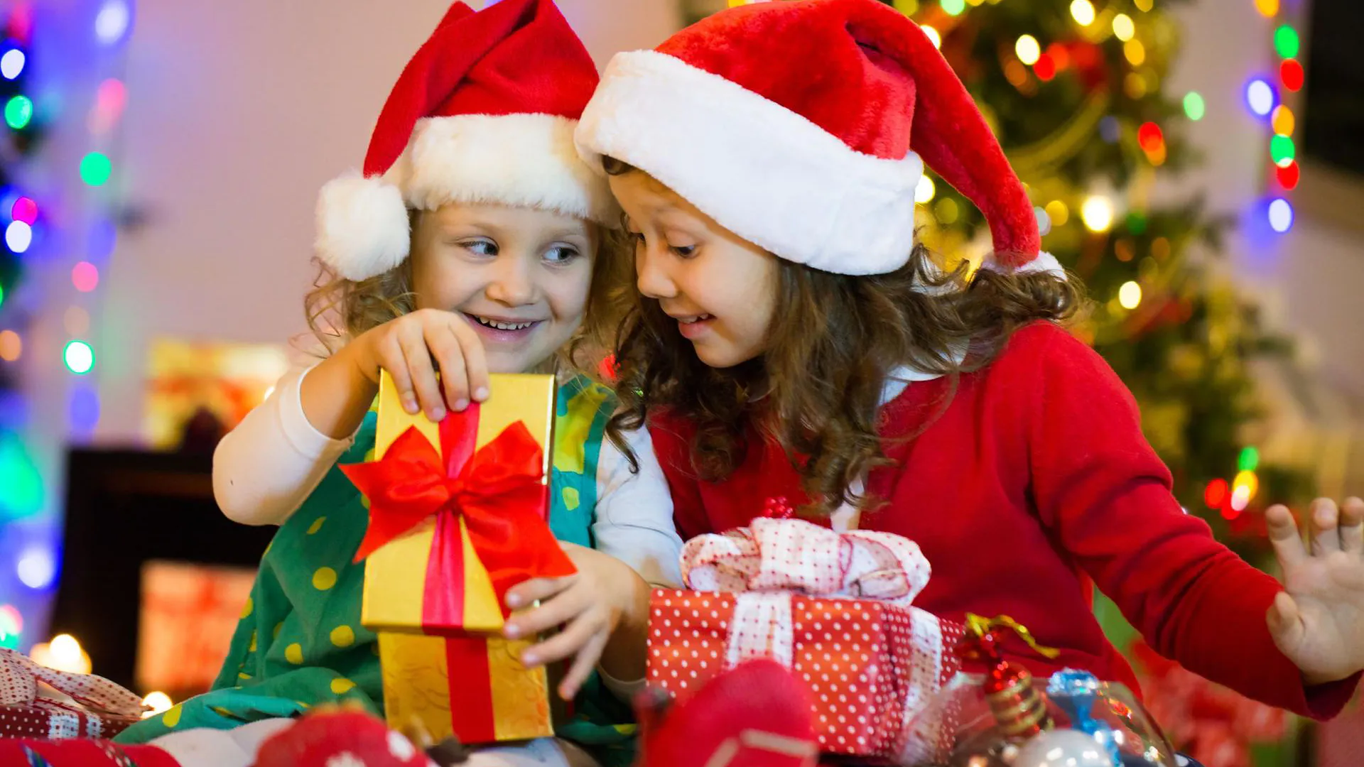
On Christmas Eve the whole family sits at the Christmas table. At the beginning of supper people are breaking and sharing of wafer. According to tradition, there should be 12 dishes on the table. The most popular are beetroot soup, carp, dumplings, cheesecake and poppy seed cake. It is also important to leave an extra plate for an unexpected guest. In most families people sing Christmas carols. When the supper is finished, children open their Christmas presents, which are hidden under the Christmas tree.

Slide 4
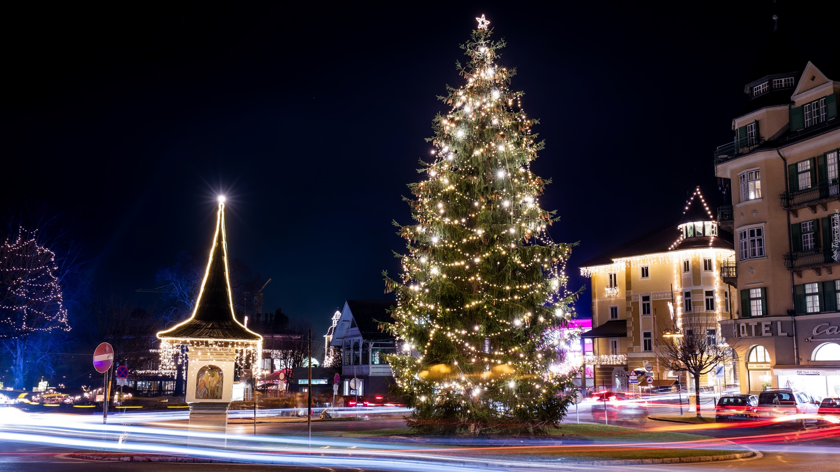
At midnight some people go to the church for Midnight Mass. It’s a special Holy Mass where people are celebrating Jesus birthdays.
For the next two days people are celebrating, spending time with others and enjoying this happy time.

Slide 5
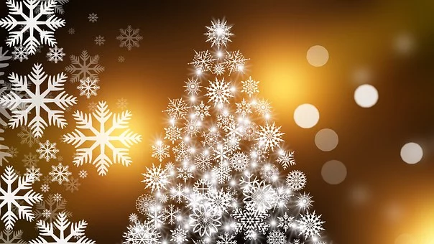
Thank you!
Adam Juszczyk

